Slide 1
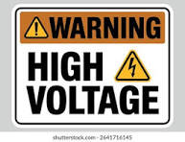
OVER VOLTAGE PROTECTION
M0PWS

Slide 2
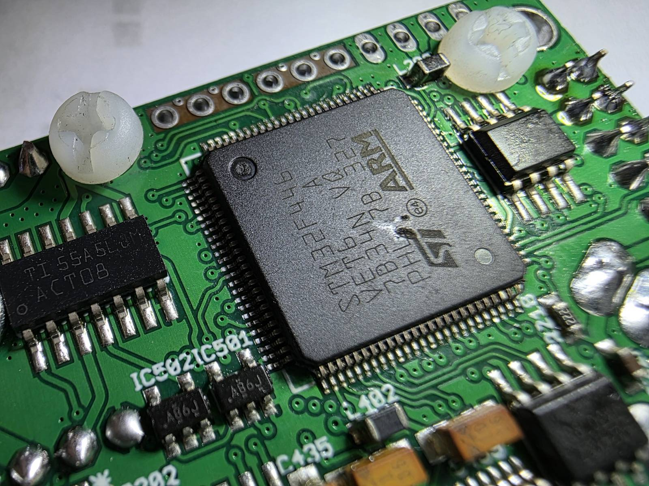
Nominal safe voltage? for Radio Equipment
13.8 Volts +- 15% = 11.73 volts to 15.87 Manufactures specification?
Some information on internet shows equipment has survived 18 volts for short periods of time.
20 to 30 volts can cause catastrophic problems. Linear AND switched mode supplies can generate fault voltages in this range.
24 Volt damage to IC on radio.
NB Additional component damage
occurred.

Slide 3

Icom Warranty statement
Before you connect your radio to a power supply
There are currently a considerable number of power supplies in the Amateur radio market that claim to be 13.8 volts at high currents. Several of them produce a high voltage at switch on that can damage your Amateur radio base station/mobile.
Before you use such a supply, we recommend you read the following:
We are receiving for repair an increasing number of radios that have been subject to “Over Volts”.
Our radios are designed to work on a supply that is 13.8 Volts and although it may withstand some additional voltage, damage will occur if excessive voltage is applied.
Although we may be able to repair the radio additional damage may have occurred that may not be apparent at the time of repair.
Radios that are returned to us for repair that have been damaged by “Over Volts” will not be repaired under warranty and any subsequent repairs may be chargeable.
It is our advice that you do not use one of these supplies and purchase an approved Icom power supply that has been designed to complement your radio.
12/06/2019

Slide 4
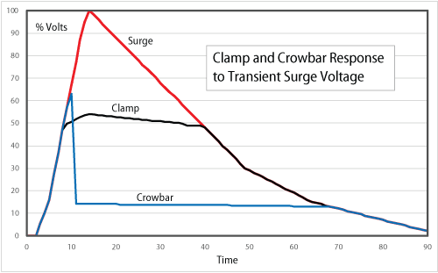
Protection Options - Crowbar, Clamp,
Switch (Open Circuit)

Slide 5
Fuses and Crowbar Circuits
The problem with traditional fuses.
FUSES are slow and unreliable compared to other circuitry that they are supposed to protect.
They often save the power supply but not the load.
Fuse under test | Fuse Rating (A) | Time to Blow at stated rating | Time to blow at 200% rating | Time to blow at 400% rating
SinglFuse™ SF-3812F-T Series | 25A | Possibly Never | 60 Seconds | Not Stated
Multicomp Fastblow | 25 A | Possibly Never | 4 minutes | Not Stated
Cooper Bussman 500 Fast Acting | 15A | Possibly Never | 2 minutes | 3 seconds
BEL SMD Fastblow | 25A | Possibly Never | Not Stated | 5 Seconds
LittelFuse ATOF® Blade Fuses | 25A | Possibly Never | 5 seconds | 500 milliseconds
G4NSJ – Power Supplies 13.8 Volt crowbar
BE WARNED! OVER VOLTAGE!
Not all 13.8 Volt power supplies incorporate an over-voltage protection circuit. I have a Watson W-30AM. This is a lovely supply, but there’s no crowbar protection. Imagine your £2000 radio suddenly having 25 Volts shoved up it… BANG! End of radio! I also have a couple of Palstar PS-30M 30 Amp PSUs. Again, no over-voltage protection. I lost a nice Yaesu 1500M 2 metre radio earlier this year… it didn’t like 25 Volts!

Slide 6

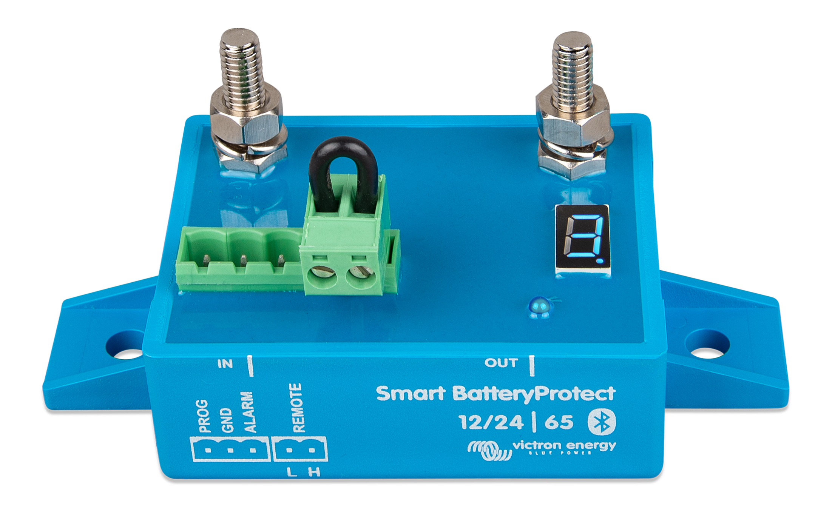
Victron Energy BatteryProtect 12/24-Volt 65 amp(Switch option)
65 Amp Continuous - 250 Amps for 30 Seconds ~ £32 to £35

Slide 7
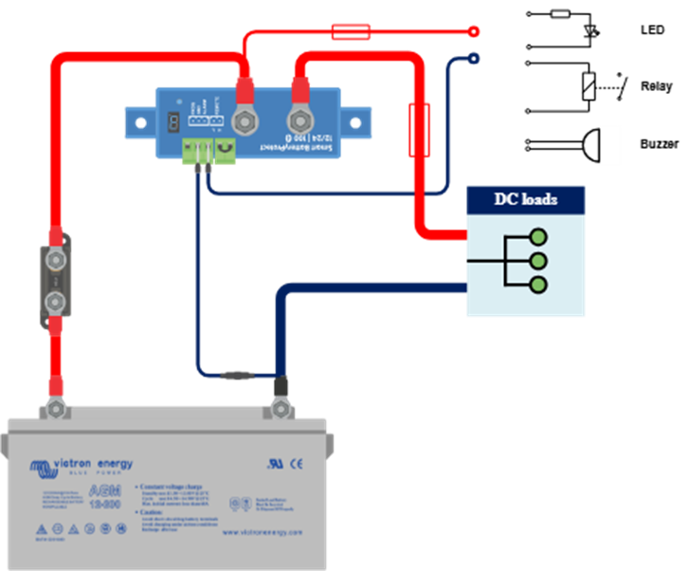
Basic Circuit Diagram
• Mode A: Buzzer or LED mode (default).
• Mode B: Relay mode.
• Mode C: Li-ion mode
Display Under voltage shutdown Under voltage restart
0 10.5 V/ 12.0V/
1 10.0V/ 11.5V/
2 9.5V/ 11.5V/
3 11.25V/ 13.25V/
4 11.5V/ 13.8V/
5 10.5V/ 12.8V/
6 11.5V/ 12.8V/
7 11.8V/ 12.8V/
10.0V/ 13.2V/
• E1 Short circuit
• E2 Over temperature / P2 Over temperature warning
• E3 Under voltage / P3 Under voltage warning
• E4 Over voltage

Slide 8
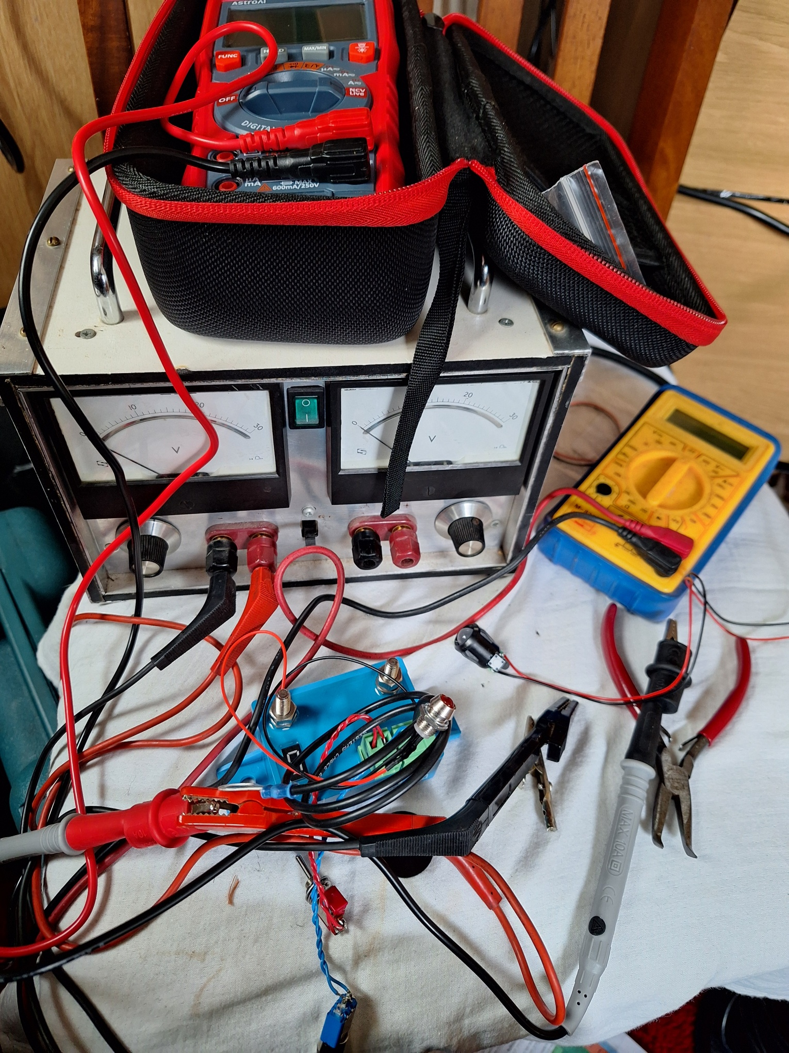
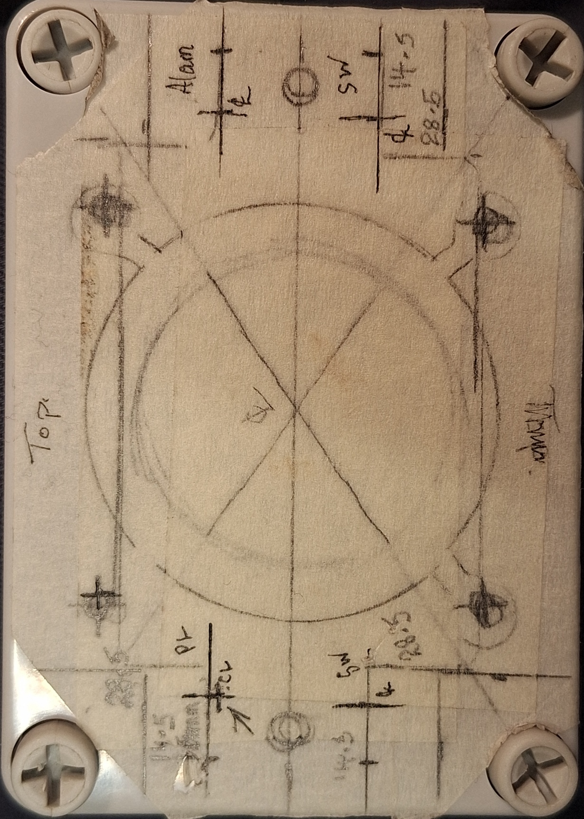
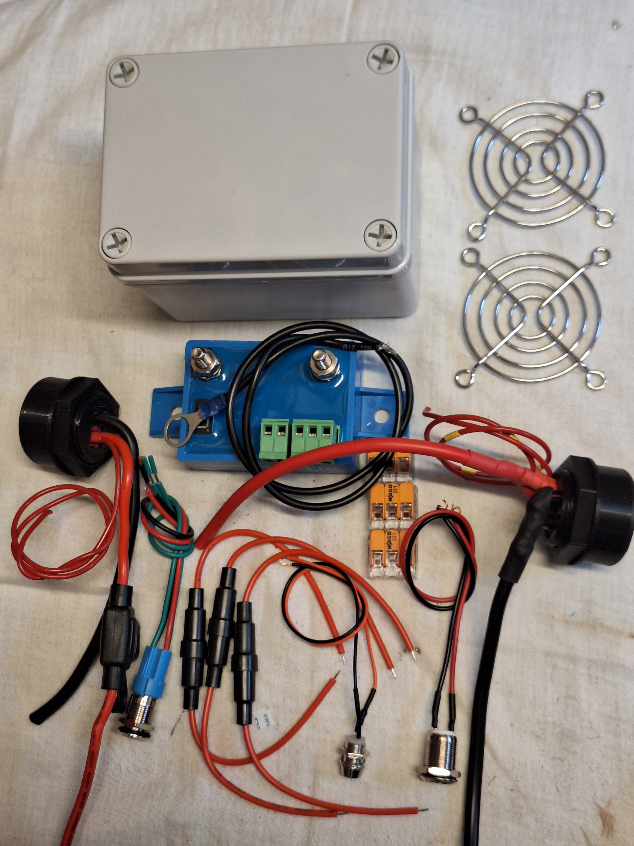
Components / Breadboard / Ventilation
OVP measures at 16.2 volts

Slide 9

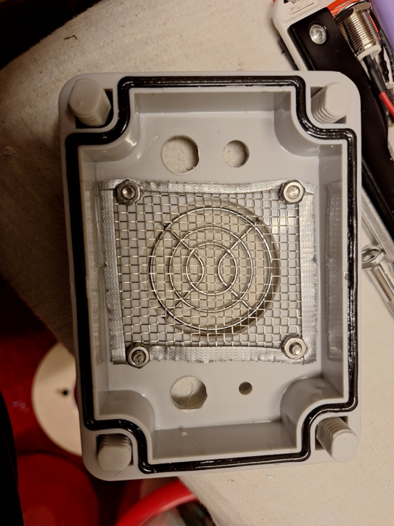
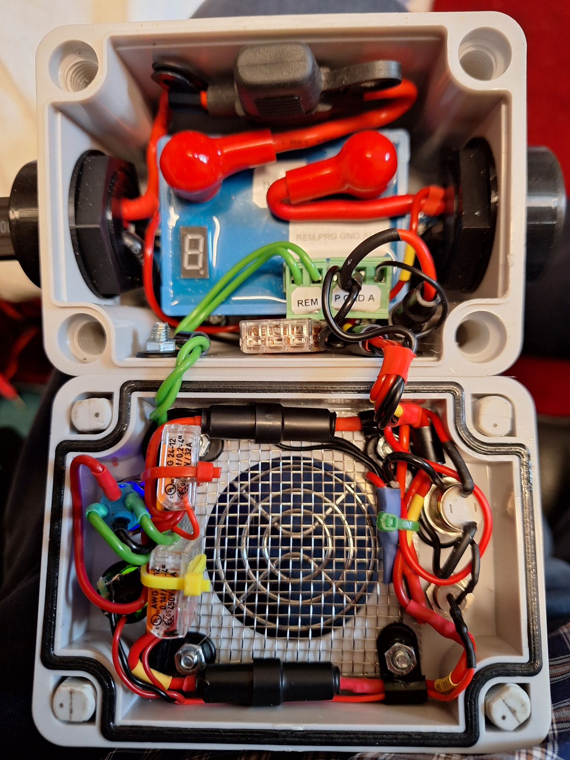
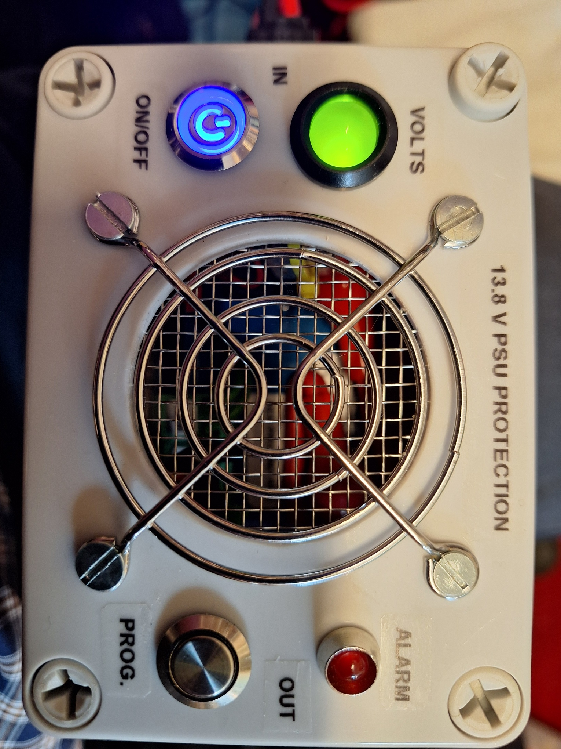
Construction & Finish

