Slide 1
Cybersecurity for Beginners
Presented to Chester & District Radio Society
Jonathan Grady (M7UHC)

Slide 2
What is Cybersecurity?
Protection of systems and data from unauthorised access, attack, or damage
Safeguarding confidentiality, integrity, and availability of information (the “CIA triad”)
Defending against threats such as hacking, phishing, malware, and ransomware
Managing risk by identifying vulnerabilities and reducing exposure
People, process, and technology combined to keep organisations secure
Ensuring business continuity so services keep running even during attacks

Slide 3
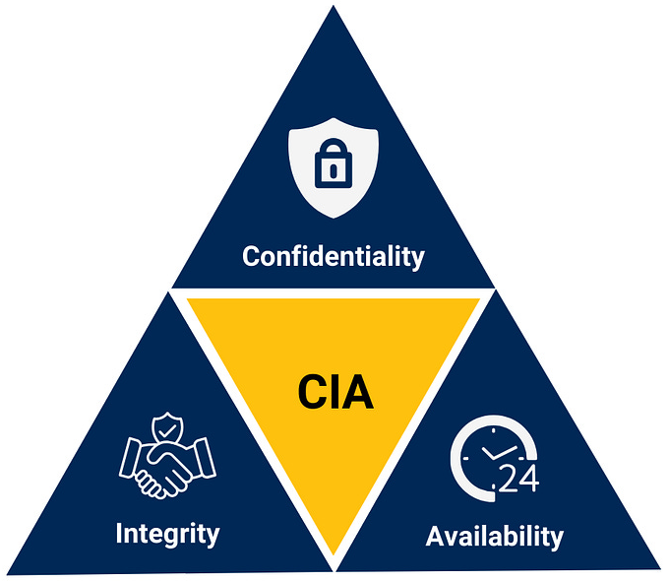
The CIA Triad
Confidentiality – Making sure information is only accessible to authorized people (e.g. passwords, encryption, access controls)
Integrity – Ensuring data is accurate and hasn’t been altered or tampered with
Availability – Ensuring systems and data are accessible when needed (e.g. backups, redundancy, protection against outages or ransomware)

Slide 4
I’m OK, this is only for businesses!
Everyone is a target, not just large companies or governments
Personal data is valuable (emails, bank details, identities can be sold or misused)
Financial fraud risk from phishing, scams, and stolen credentials
Identity theft can lead to accounts being opened or services used in your name
Social engineering attacks exploit human behavior, not just technology
Your digital footprint matters (social media, online accounts, stored data)
Good habits at home improve workplace security and vice versa

Slide 5
Types of Attacks

Slide 6
Phishing
Social engineering attack involving trickery
Designed to gain access to systems or steal data
Targeted phishing is “spear phishing”
Variants include “vishing” – attacks by telephone and “smishing” those using SMS or text

Slide 7
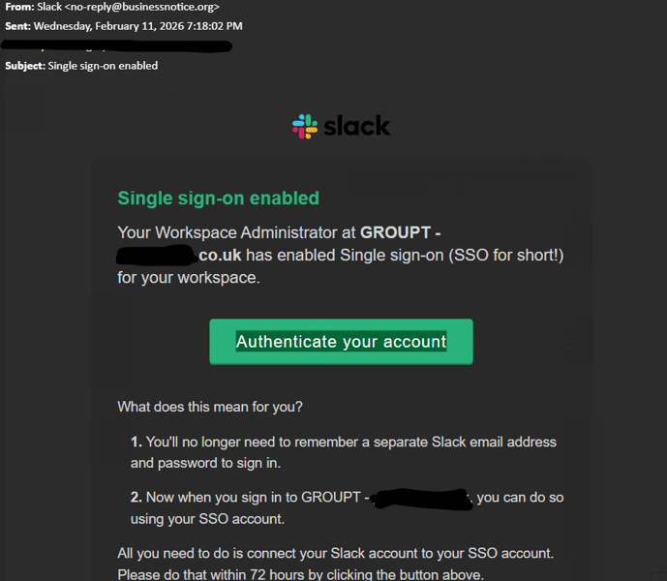
Phishing – an example

Slide 8
Ransomware
Type of software with malicious intent and a threat to harm your data
The author or distributor requires a ransom to undo the damage
No guarantee the ransom payment will work
Ransom often needs to be paid in cryptocurrency

Slide 9
Imposter Scams
Someone “official” calls or emails to report a crisis situation
They represent the Tax Office, DVLA, a Bank, the Lottery or Technical Tupport
There will be a sense of urgency and a dire penalty or loss if you don’t act

Slide 10
Environmental Threats
Natural threats such as fire, earthquake, flood can cause harm to computers or disrupt business access
Recovery efforts attract scams such as financial fraud
Downtime can lose customers, clients who can’t wait

Slide 11
What can you do to help protect yourself?

Slide 12
What are you protecting?
Identify the data you wish to keep safe e.g. family photos, passwords etc
Identify the value of these e.g. which is most important
Backup information to external storage. Use the 3, 2, 1 method
Document all of the above
*Can be used for not just digital data but physical also

Slide 13
Simple Task
On your smart phone go through all of the installed apps and make a note of all the username and passwords needed for each.
They very quickly add up!

Slide 14
Passwords

Slide 15
What are passwords?
Secret combination of characters that only a user should know.
Passwords are a compromise between security and convenience
Password security used to secure information, and provide that information to authorized users easily.

Slide 16
How are Passwords Compromised?
Brure Force
Dictionary Attack
Using the same password across multiple services
Social Engineering
Breaches \ data leaks
Written down on paper

Slide 17
What is a safe password?
Basic goal of a secure password is one that is easy for YOU to remember but hard for someone else to find out Long complicated passwords are not always the best solution
E.g. : random password like !$fjDd&^fw43_f%@+
Will you really be able to memorize that?
If a password is too complicated and hard to remember, you are likely to write it down, need password resets
A password is only as secure as the weakest system you use it on

Slide 18
Password Managers
1Password
LastPass
KeepassXC
Proton Pass
Keeper
Keyring
Google Chrome
Etc etc

Slide 19
How Many Passwords?
Ideally 1 for every website and application
Where possible use 2FA (NOT SMS!)
Optional if available use Passkeys
Use hardware authentication

Slide 20
Antivirus

Slide 21
Something is better than nothing
Lot’s of choice’s available
All promise the world
Free versions vs paid versions
Personal recommendations Bit Defender, Malware Bytes, ClamAV for Linux

Slide 22
We’re nearly at the end, I promise ;-)

Slide 23
Cybersecurity Myths
“I'm too small to be a target” - False
“Antivirus is enough” - False
“Strong passwords alone keep me safe” - False
“I use X operating system, I’m safe” - False

Slide 24
Data Protection Best Practices
3-2-1 backups
Enable 2FA
Keep devices updated
Avoid public WiFi
Review app permissions
Limit social media exposure

Slide 25
Red Flags to Spot Attacks
Urgent emails
Unexpected attachments
Strange sender address
Payment detail changes
Vague phone calls asking for information or from your Bank, Microsoft or PayPal
URL’s that do not match the intended website

Slide 26
If You're a Victim
Don’t Panic
Disconnect \ turn off the device
Change passwords
Contact bank if needed
Report to https://www.reportfraud.police.uk/
or https://www.ncsc.gov.uk/
Restore backups
Seek trusted help if required

Slide 27
Any Questions?

