Slide 1
Digital Mobile Radio (DMR)
A Brief User Guide to
By
Graham Pemberton G7NEH
and
Paul Henry 2E0SQK

Slide 2




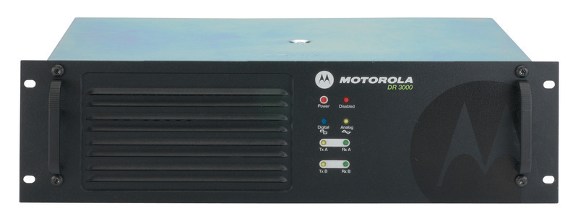
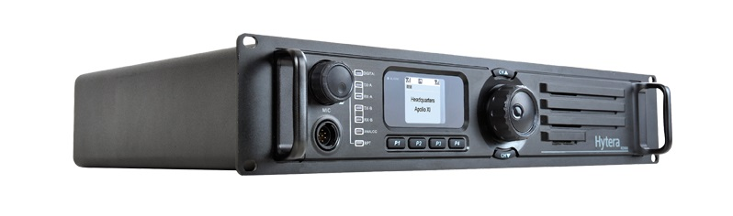
DMR Networks

Slide 3
Amateur Radio use of DMR in the UK
First UK DMR-MARC repeater GB7TD went live on 24th July 2013
First UK DMR Plus repeater GB7RR 14th February 2015
Now around 70 repeaters in the UK

Slide 4
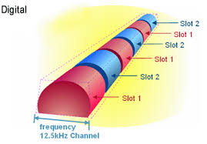
How it Works (the basic facts)
DMR employs Time Division Multiple Access (TDMA)
This enables TWO discrete ‘Time Slots’ within one 12.5khz frequency allocation
Two QSO’s possible simultaneously on one repeater
Notes:
that enables two discrete ‘Time Slots’ – effectively two separate voice channels within one 12.5kHz frequency allocation – so two QSOs are possible simultaneously.
Additionally, these slots are software routed to various ‘Talk Groups’ that allows the user to make an area or group speci c call

Slide 5
Benefits of DMR
First used for commercial applications in 2005
Equipment is of commercial quality
Superior voice quality
Longer battery life
Supports multiple Talk Groups on one channel
Notes:
the system was designed from the outset to comply with tight emissions specications set by the European Telecommunication Standards Institute (ETSI) and Federal Communications Commission (FCC). Consequently
but competition and sheer numbers make new and used gear available relatively inexpensively.

Slide 6
Talk Groups
Talk Groups (TG) are a way for groups of users to share a Time Slot ( one-to-many) without distracting other users of that Time Slot
Only one Talk Group can be using a Time Slot at a time.
If your radio is not programmed to receive a Talk Group, you will not hear anything

Slide 7
Talk Groups
Common to most UK repeaters
Time Slot 1 Time Slot 2
TG 1 World Wide Calling TG9 Local
TG2 Europe TG8 Regionel
TG 13 World Wide English
TG235 UK Wide
TG9 Local
Direct Dial

Slide 8
Color codes
DMR repeaters use Color Codes (CC) much like analog repeaters use CTCSS. To access a repeater you must program your radio to use the same CC as the repeater. There are 16 different CCs (CC0- CC15). The use of Color Codes is not optional on DMR systems. If your Color Code is not set correctly, you will not be able to access the repeater. The only real purpose of using different Color Codes is when multiple repeaters operating on the same frequency have overlapping coverage areas

Slide 9
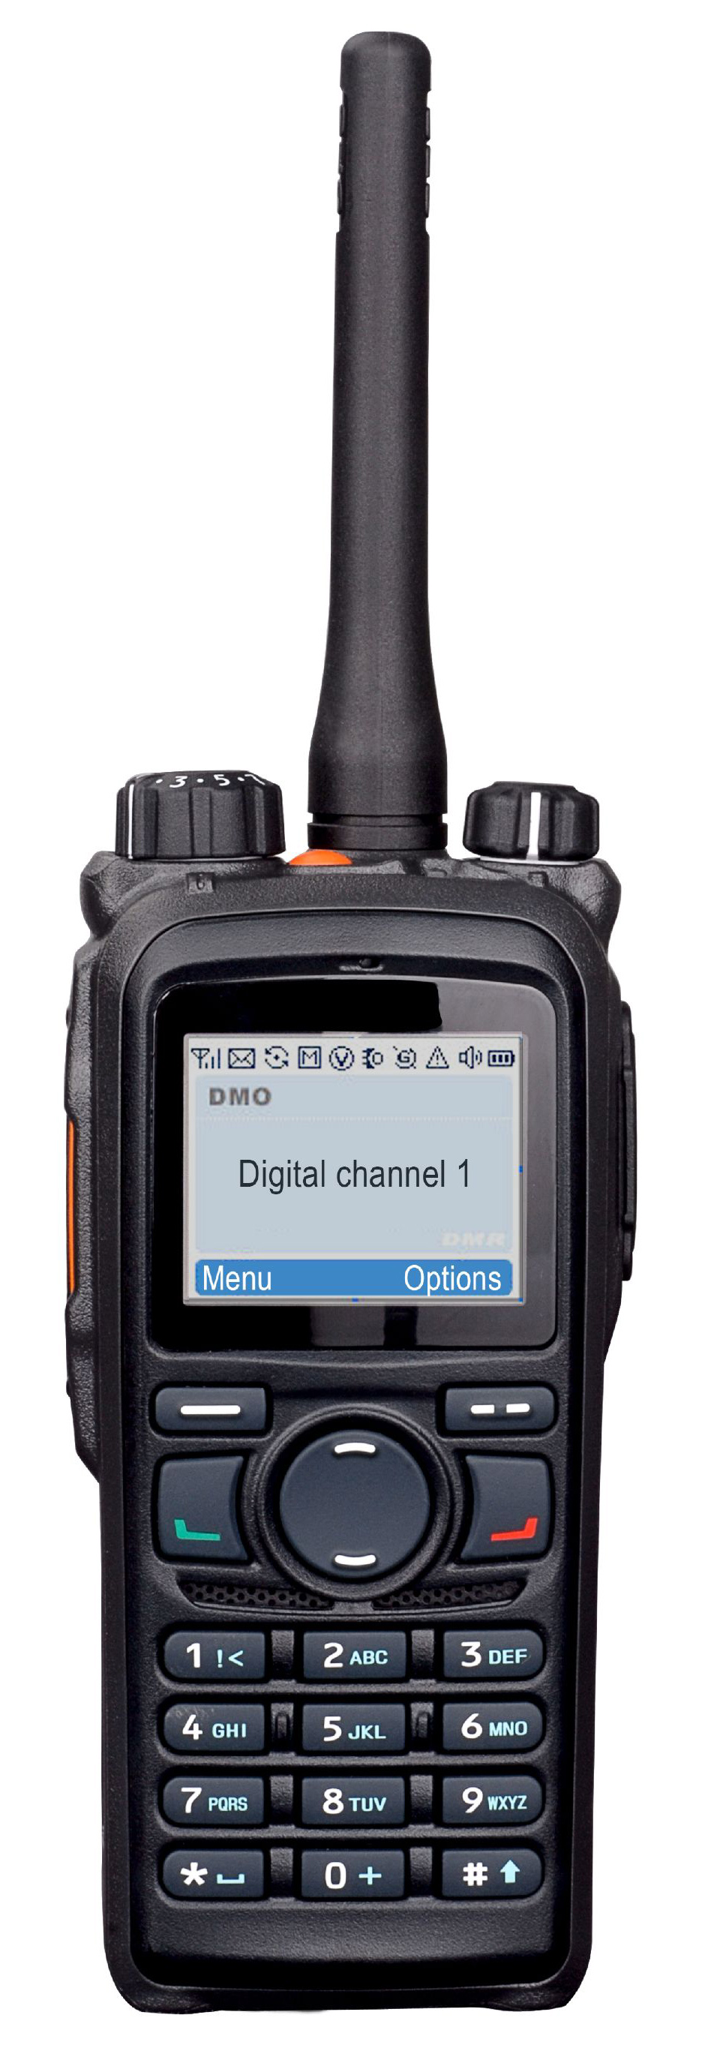
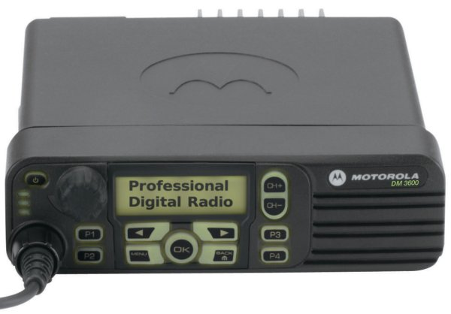
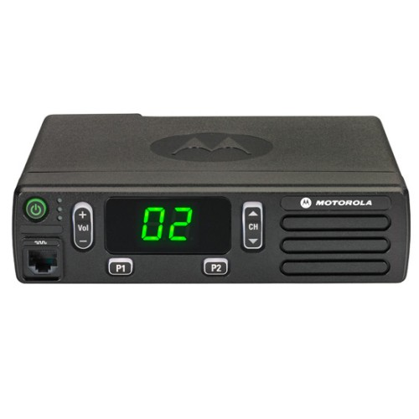
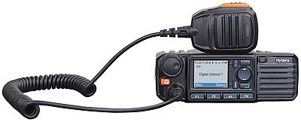
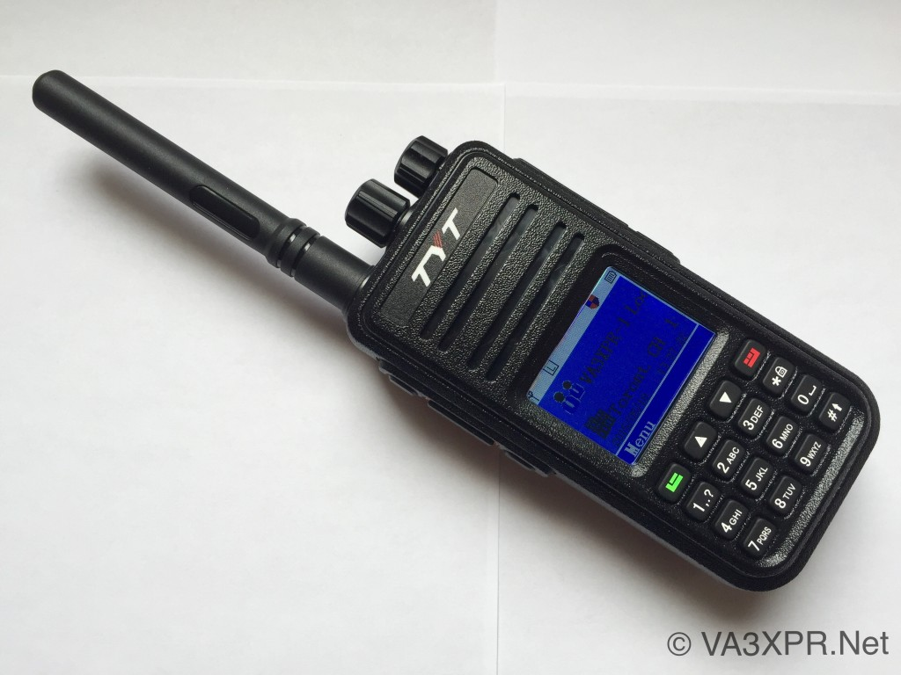
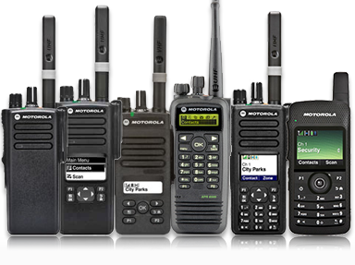
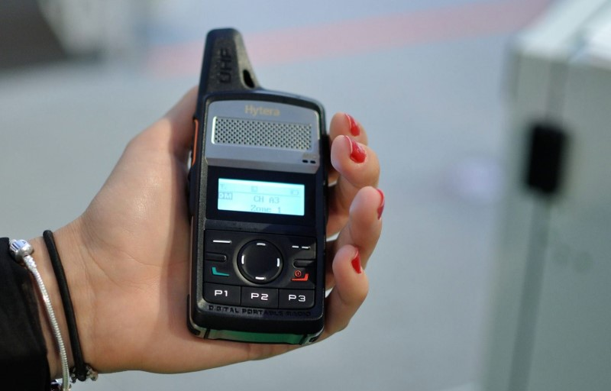
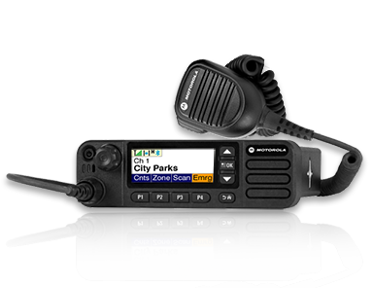
Available Radios – some examples

Slide 10
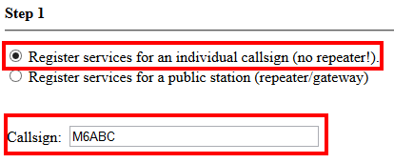
Getting on the Air (your first steps)
Get a DMR ID number by going to http://register.ham-digital.net

Slide 11
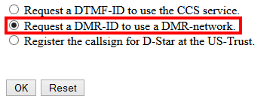
Getting on the Air (your first steps)
Get a DMR ID number by going to http://register.ham-digital.net

Slide 12
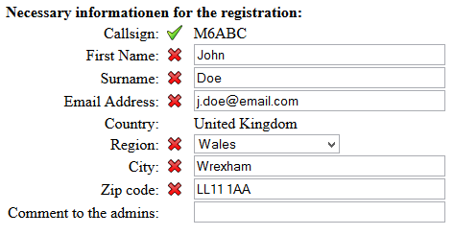

Slide 13
Programming your Radio
Most DMR radios need to be programmed via software
This is known as the ‘CPS’ (Customer Programming Software)
The file you create and upload to the radio is called a ‘Code Plug’
The code plug contains all the information the radio needs such as your DMR ID, channels and many other settings
Each manufacturer produces it’s own CPS
Each radio requires a specific Code Plug

Slide 14
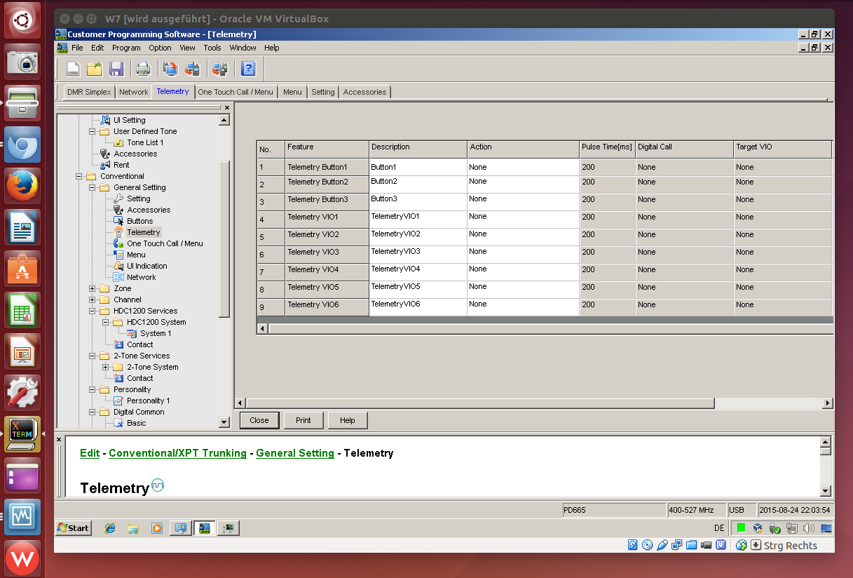

Slide 15
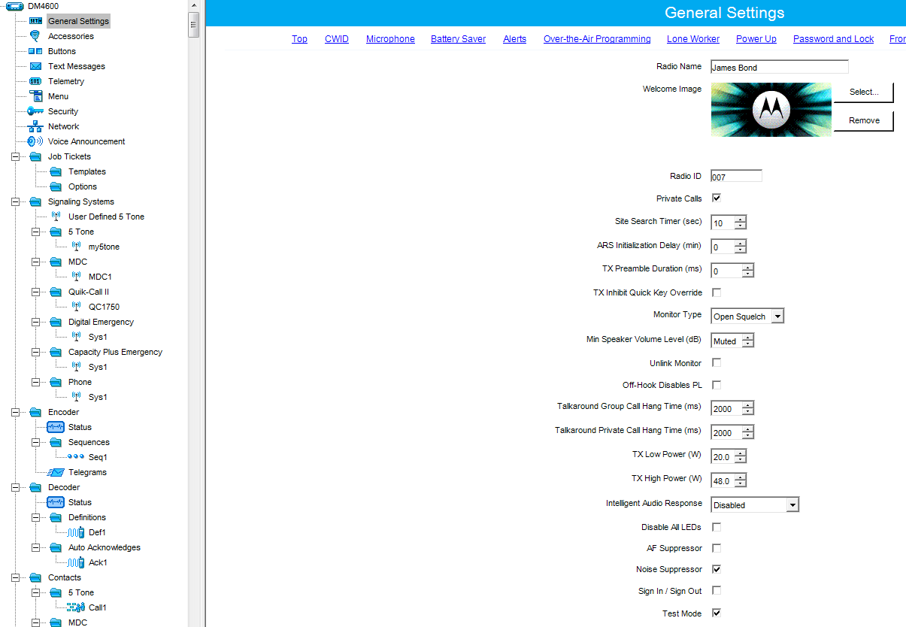

Slide 16



I need some help, where do I go !

Slide 17
I need some help, where do I go !
Some useful links
http://www.gb7hm.uk - Our local DMR-MARC Repeater
http://www.gb7fc.co.uk - Blackpool DMRplus repeater
http://dmrusers.co.uk/ - DMR User forum
http://www.cc-3.net/monitor.php - DMR Live Monitor
http://www.cc-3.net - Home of the UK C-Bridge
http://www.hamdmr.co.uk - New & second hand DMR radios
http://www.codeplugcentral.co.uk - A source for UK code Plugs
http://www.ukrepeater.net - UK repeater listings

Slide 18
The Monday night net in the UK
Time Slot 1
TG 235 UK Wide
20:00hrs
The net gives updates on new repeaters and any changes to existing ones, also invites any questions form users of the network

Slide 19
Any Questions

Slide 20
Try DMR for yourself after break!

