Slide 1
Broadband Antennas for HF
Brian Austin G0GSF

Slide 2
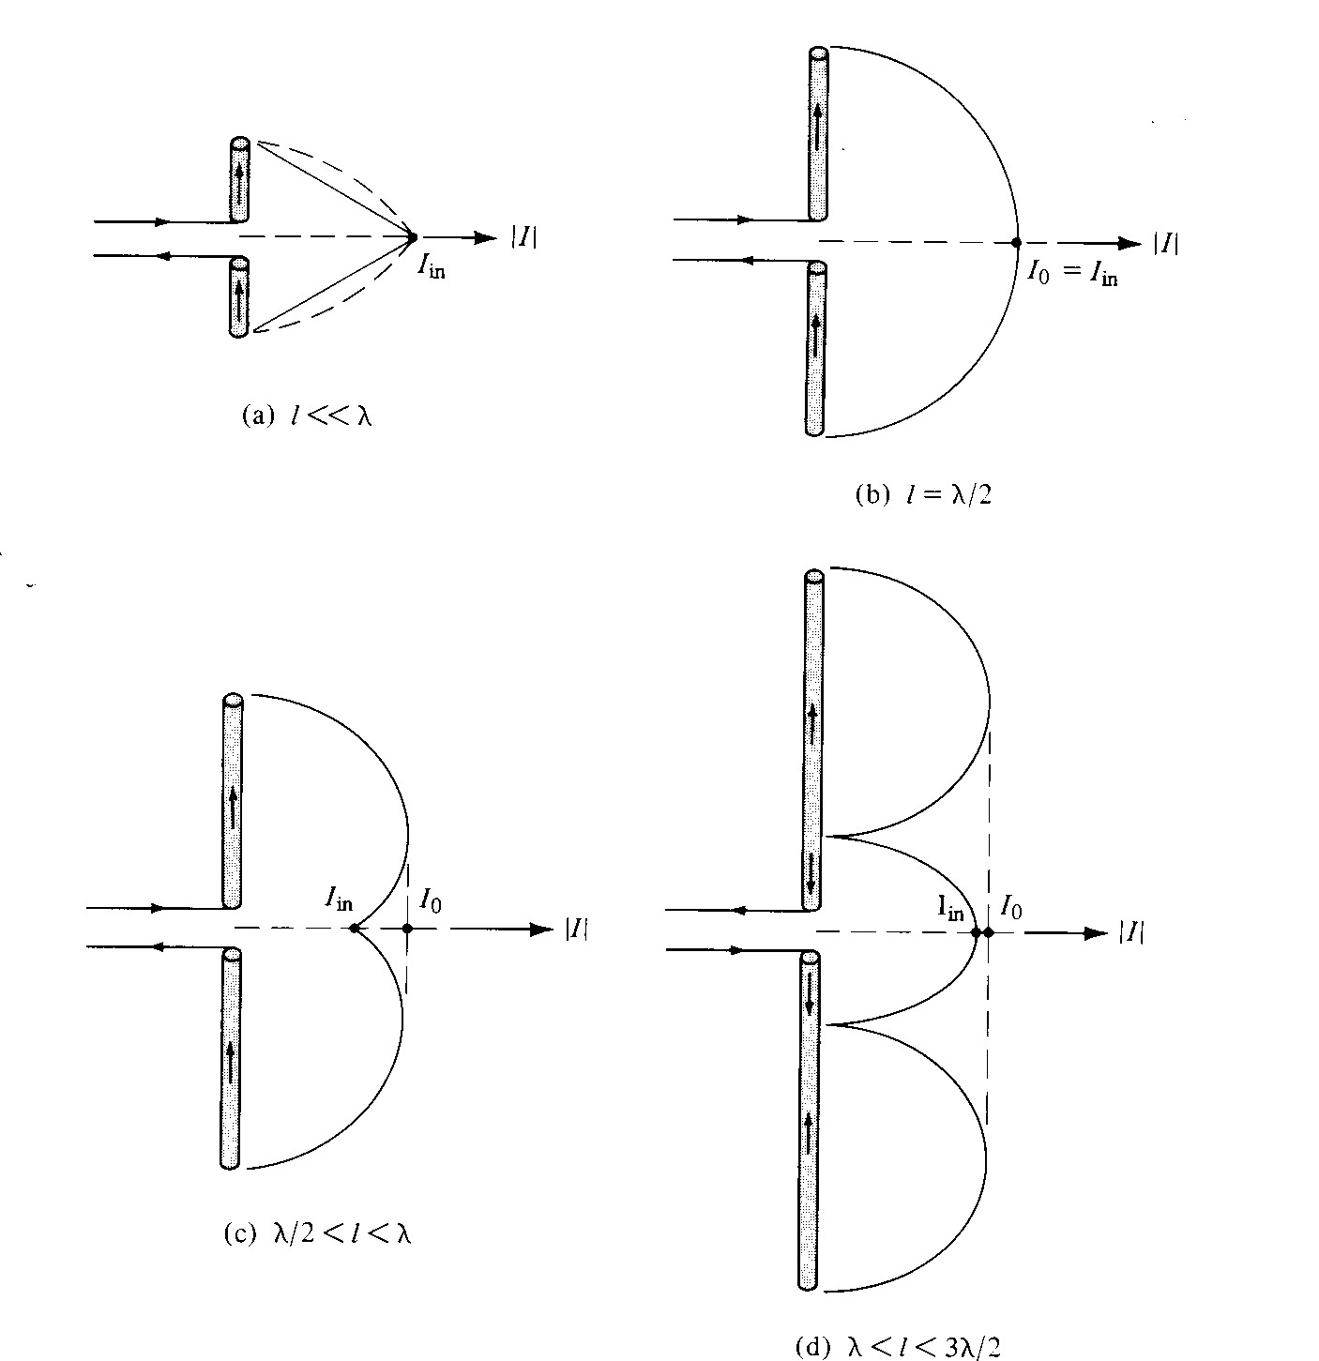

Slide 3
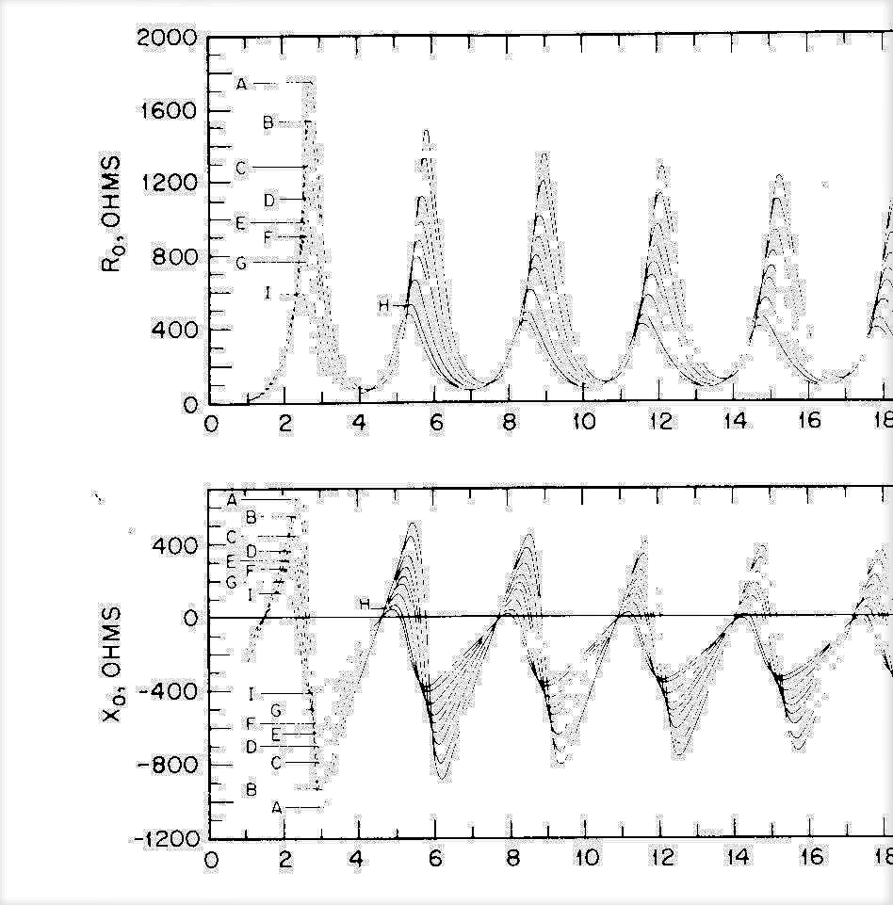

Slide 5
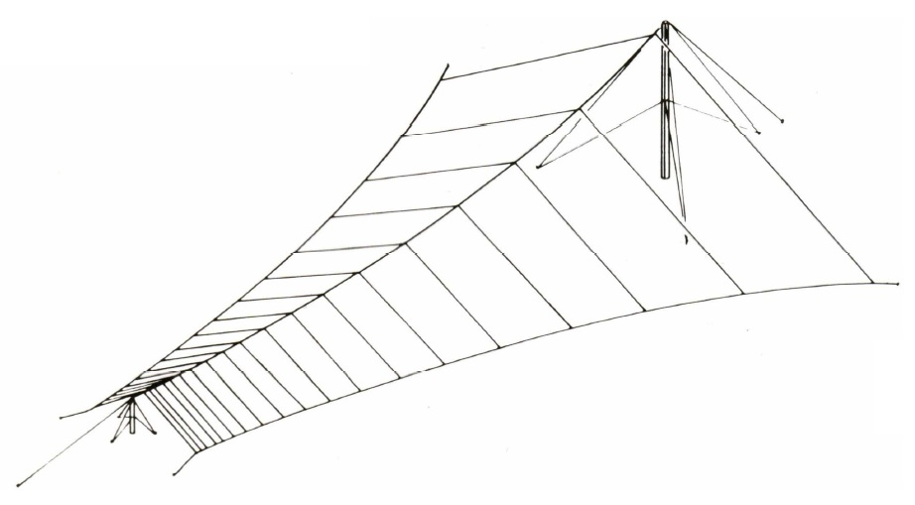
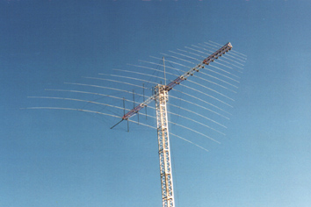

Slide 6
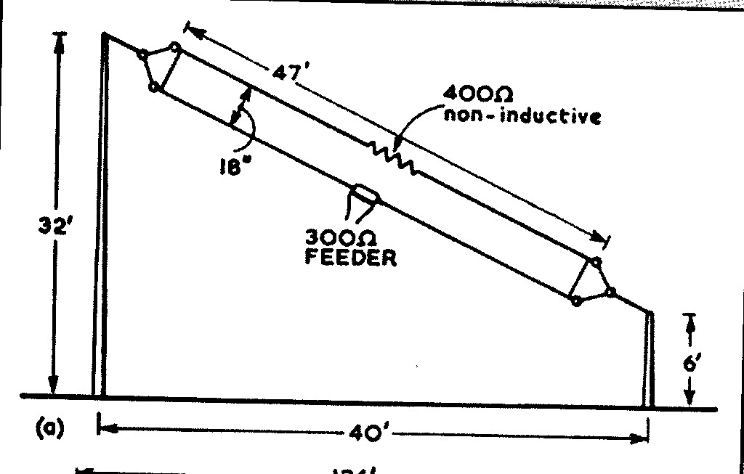

Slide 7
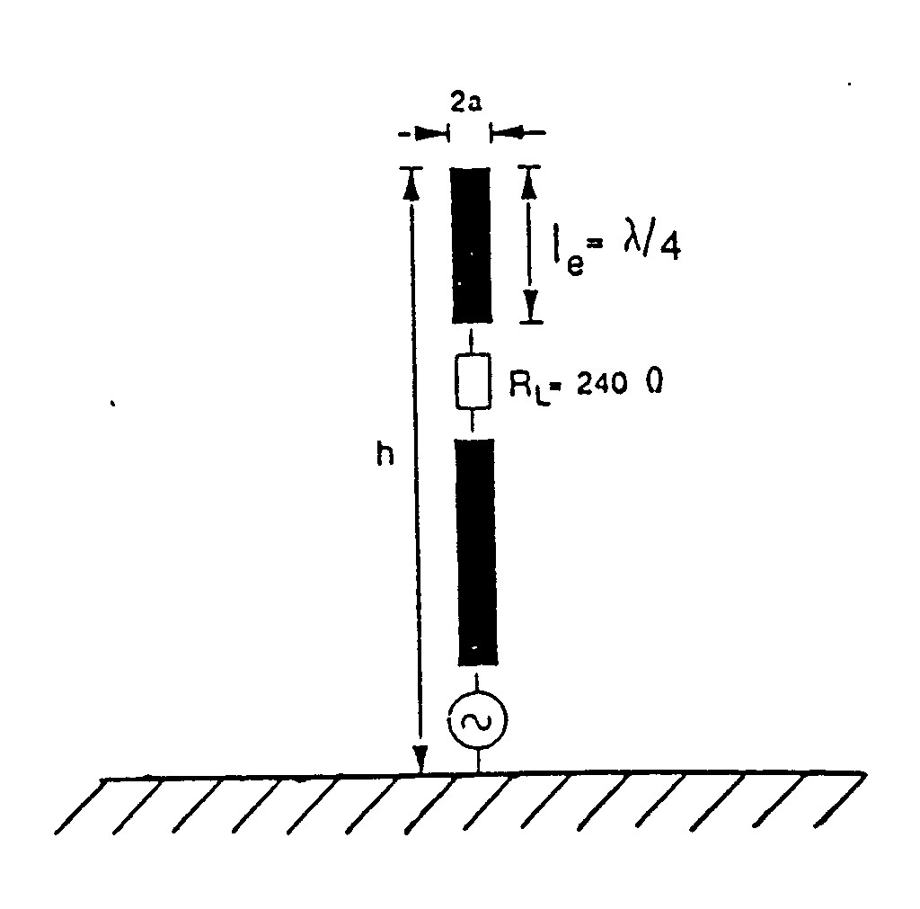

Slide 8
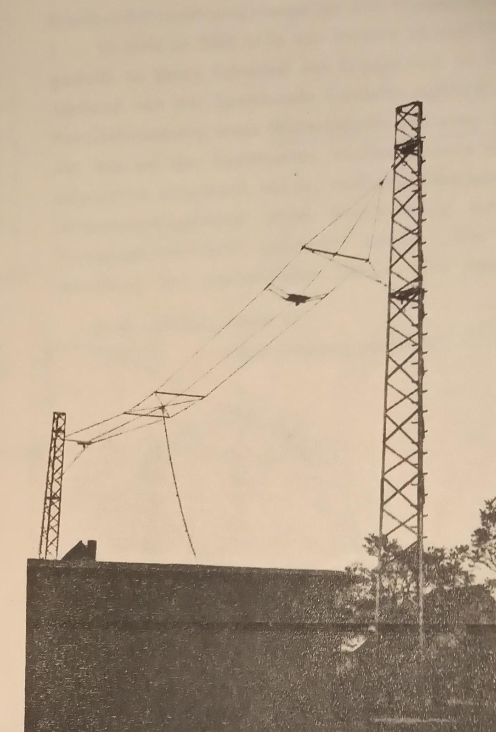

Slide 9
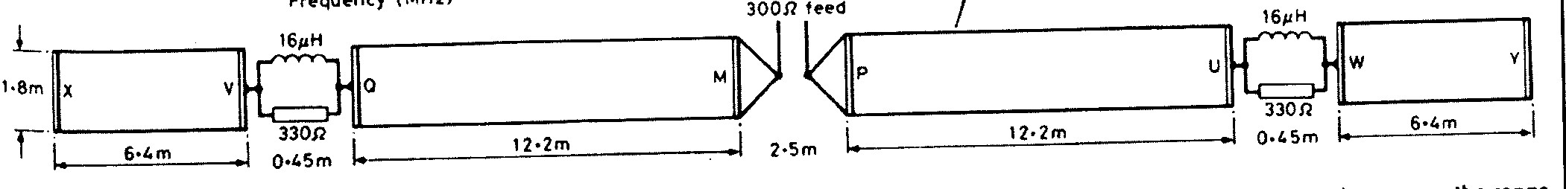
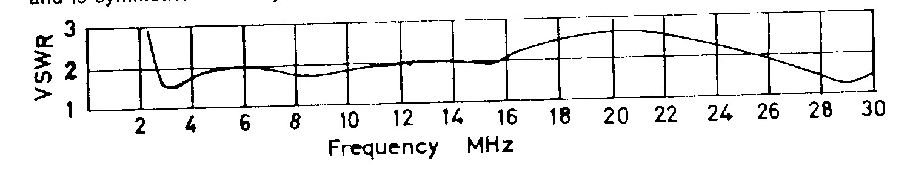

Slide 10
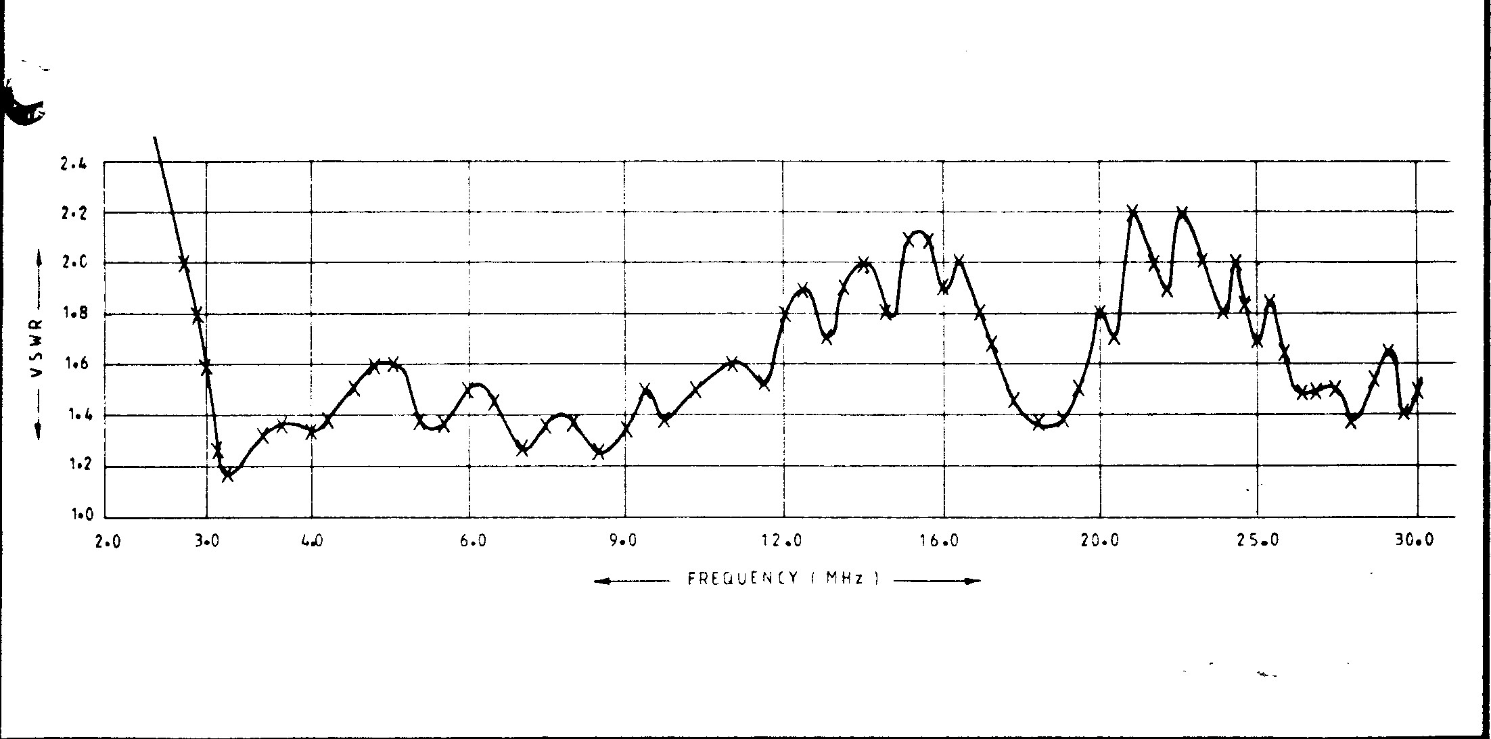

Slide 11
Frequency MHz | SWR antenna (ref 50 ohms) | SWR input (10m coax) | SWR input (20m coax) | SWR input (30m coax)
16 | 1.8 | 1.7 | 1.6 | 1.5
18 | 5.0 | 3.7 | 3.0 | 2.5
20 | 4.9 | 3.6 | 2.8 | 2.4
22 | 2.7 | 2.3 | 1.9 | 1.7
24 | 1.3 | 1.2 | 1.2 | 1.2
26 | 3.5 | 2.8 | 2.3 | 1.9
28 | 4.4 | 3.1 | 2.5 | 2.1
30 | 4.7 | 3.3 | 2.5 | 2.1
Table 1: Effect of loss on input SWR in three lengths of RG58 A/U coax cable

Slide 12
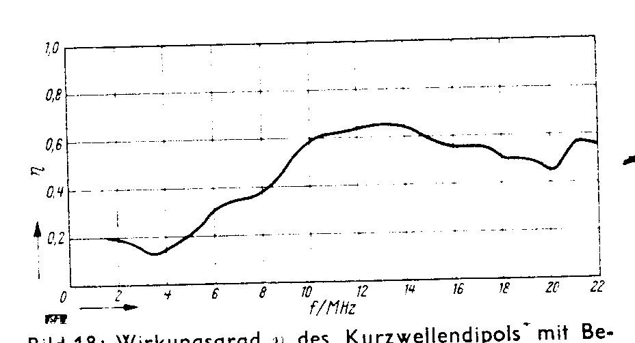

Slide 13
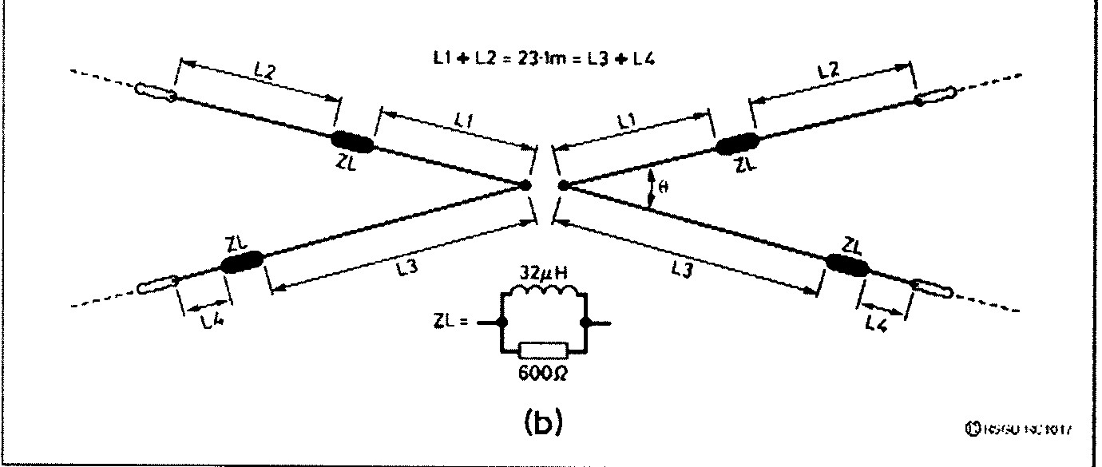

Slide 14
