Slide 1
The difference between a Balun and an UnUn

Slide 2
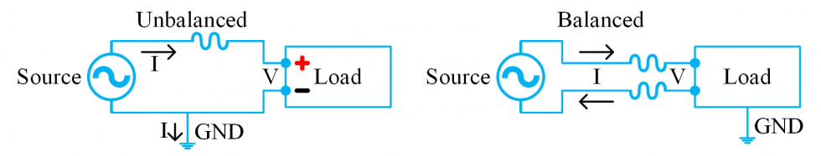
Baluns are designed to match impedances between balanced and unbalanced circuits, whereas “ununs” provide impedance matching between two unbalanced circuits.

Slide 3
Current versus Voltage Baluns

Slide 4
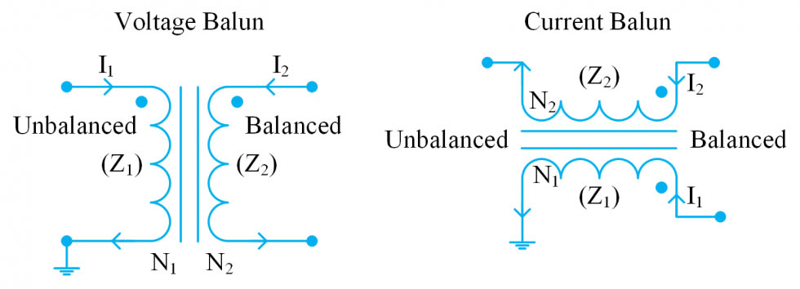
There are two main modes of baluns: current baluns and voltage baluns. Current baluns operate by forcing equal currents on both balanced lines, effectively eliminating common-mode currents. Voltage baluns force equal voltage on each balanced line; this is ultimately a better fit for impedance matching applications.

Slide 5
What is a Common Mode Choke?
To present a relative large impedance to common currents that flow over the coax outer shield/screen in order to reduce/eliminate radiation from the screen of the coax.

Slide 6
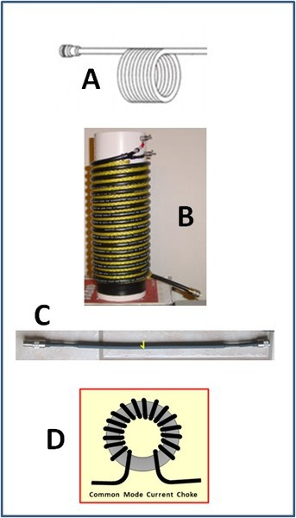
Types of CMC
COILED COAX ie self-supporting
COILED COAX ON A FORMER CHOKE
FERRITE BEADS OVER COAX
COAX WOUND ON A LARGE TOROID

Slide 7
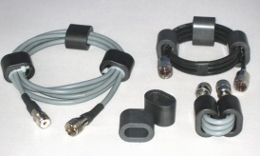
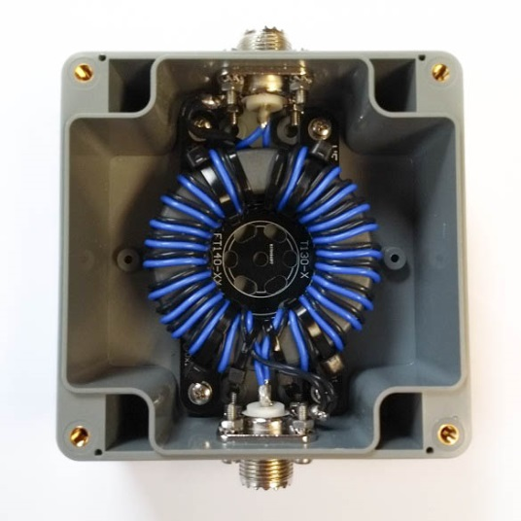
Types of CMC contd.
E. COAX LOOPED THROUGH FERRITE CORES
Commercial kit
(HF Kits)

Slide 8
Useful Links
The Radio Rover
  https://www.youtube.com/channel/UC5QimXRvJ72gABQ2dGj_9Jw
Which Balun, UnUn or Choke to use and why?
  https://www.youtube.com/watch?v=A2Tq7AWIRwE
MM0OPX - Best Ferrite Core For a 100w End Fed Half Wave Antenna
  https://www.youtube.com/@MM0OPXAmateurRadio
End Fed Half Wave Transformers.......Are they as good as we think?
  https://www.youtube.com/watch?v=nZ-G4hJCTSM

