Slide 1
Data Modes – some thoughts
Or
“it’s not real radio”

Slide 2
Confusing?
A victim of its own success
Too many acronyms
Too much confusing jargon
Too many different modes
Too difficult to set up
Belittled by tradionalists

Slide 3
Early evolution in receiving
CW – decoded between the ears
RTTY & SSTV – required a terminal unit between the Teleprinter or Camera/Monitor and the Transceiver
Packet (AX25)/Amtor required an interface unit (TNC) between the Transceiver and the PC

Slide 4
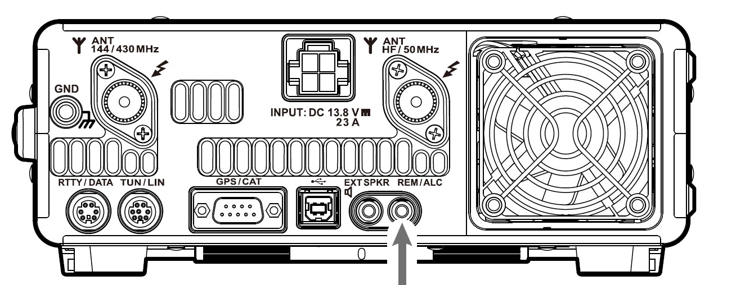
The confusion starts at the back of the rig!
Serial data interface or RTTY/Data or USB?

Slide 5
Which to use?
RTTY/Data provides PTT control and FSK (Audio Signals) requiring a further Interface box connected to the PC
Serial Port connects directly via an RS232C cable for the FT991A but may require an external interface such as a Serial to USB converter.
USB connects directly to rigs with a USB interface.

Slide 6
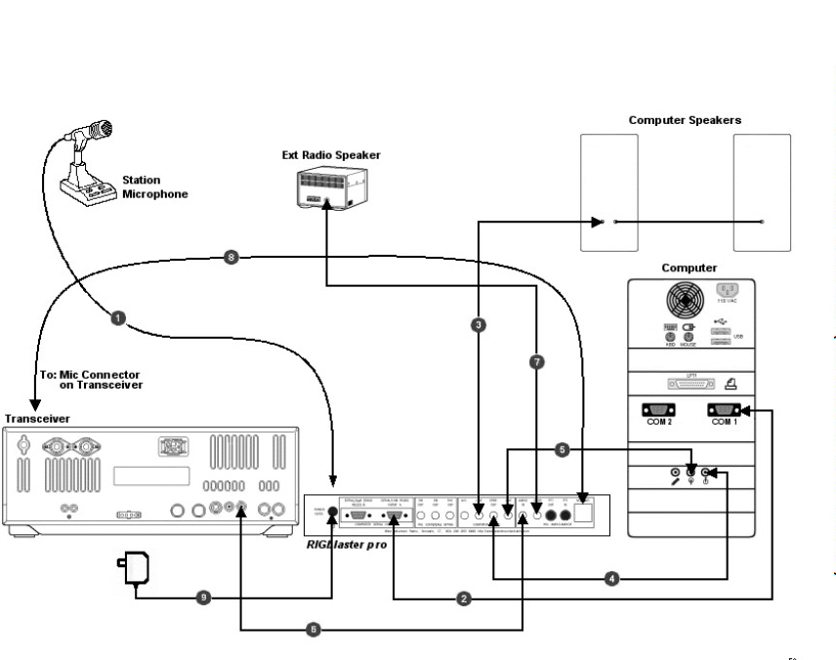
Using an audio to serial interface such as the Rigblaster.

Slide 7
or
Rigs such as the FT991A have a built in Soundcard connecting to your Transceiver via a USB socket allowing Computer Aided Tuning (CAT) for PTT & rig control and Audio In/Out to pass via a single USB cable

Slide 8
Now the PC Software
Essentially three types;
Rig Control software such as Win4Yaesu Suite and many others
Mode/multimode specific software such as MMTTY, WSJTX and many others
Integrated software combining rig control, data modes decoding and logging. Best example Ham Radio Deluxe and DXLab.

Slide 9
What could go wrong?
Setting up the rig for data working requires;
Mode setting (usually USB) & PSK
PTT settings
Data In (usually rear for USB)
CAT Speed typically 4800bps
In some cases the correct parameters will be set/modified within the PC software.

Slide 10
What could go wrong?
Setting up the PC for data working requires;
Installing correct drivers in PC for your transceiver
Select correct COM port
Changing Soundcard settings
Setting Soundcard volumes

Slide 11
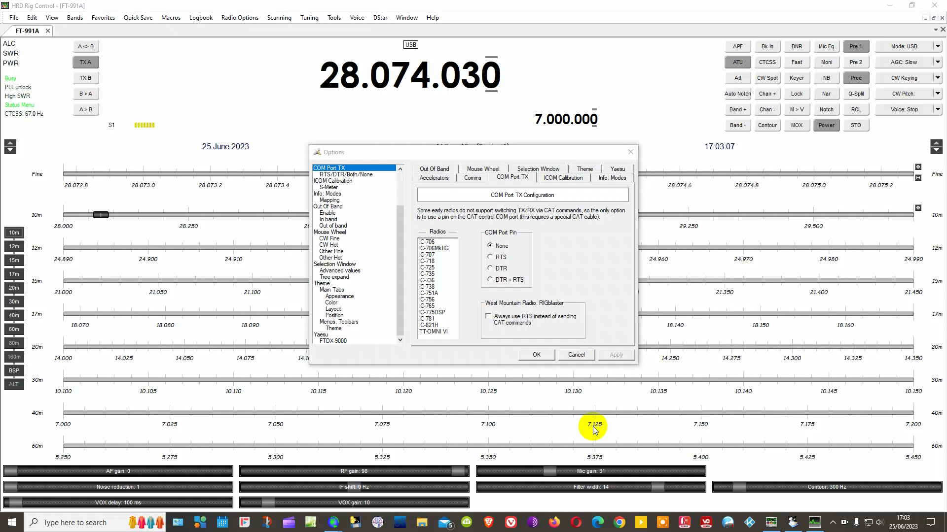
What could go wrong?
Setting up the PC software;

Slide 12
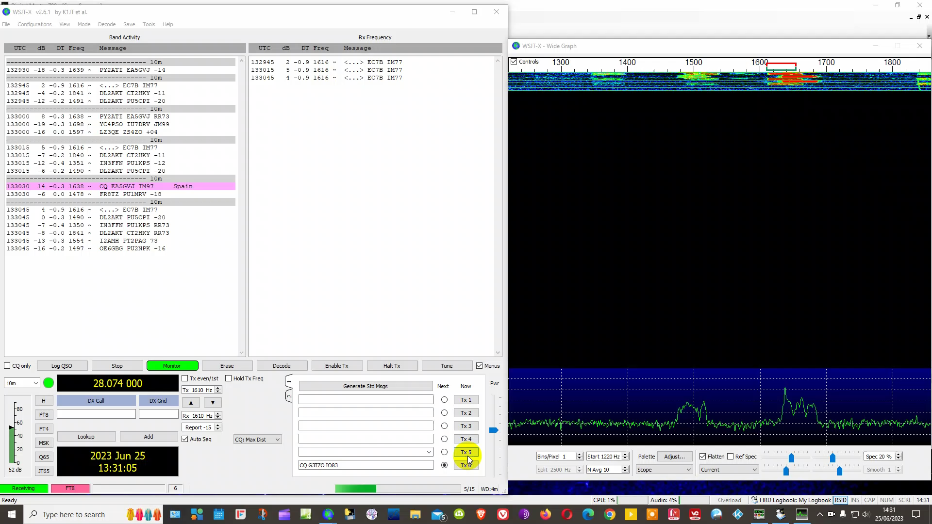
And after all that…..

Slide 13
