Slide 1
A 40m XTAL
Transceiver
For £20
Based on Homebrew Kits
G4FVZ

Slide 2
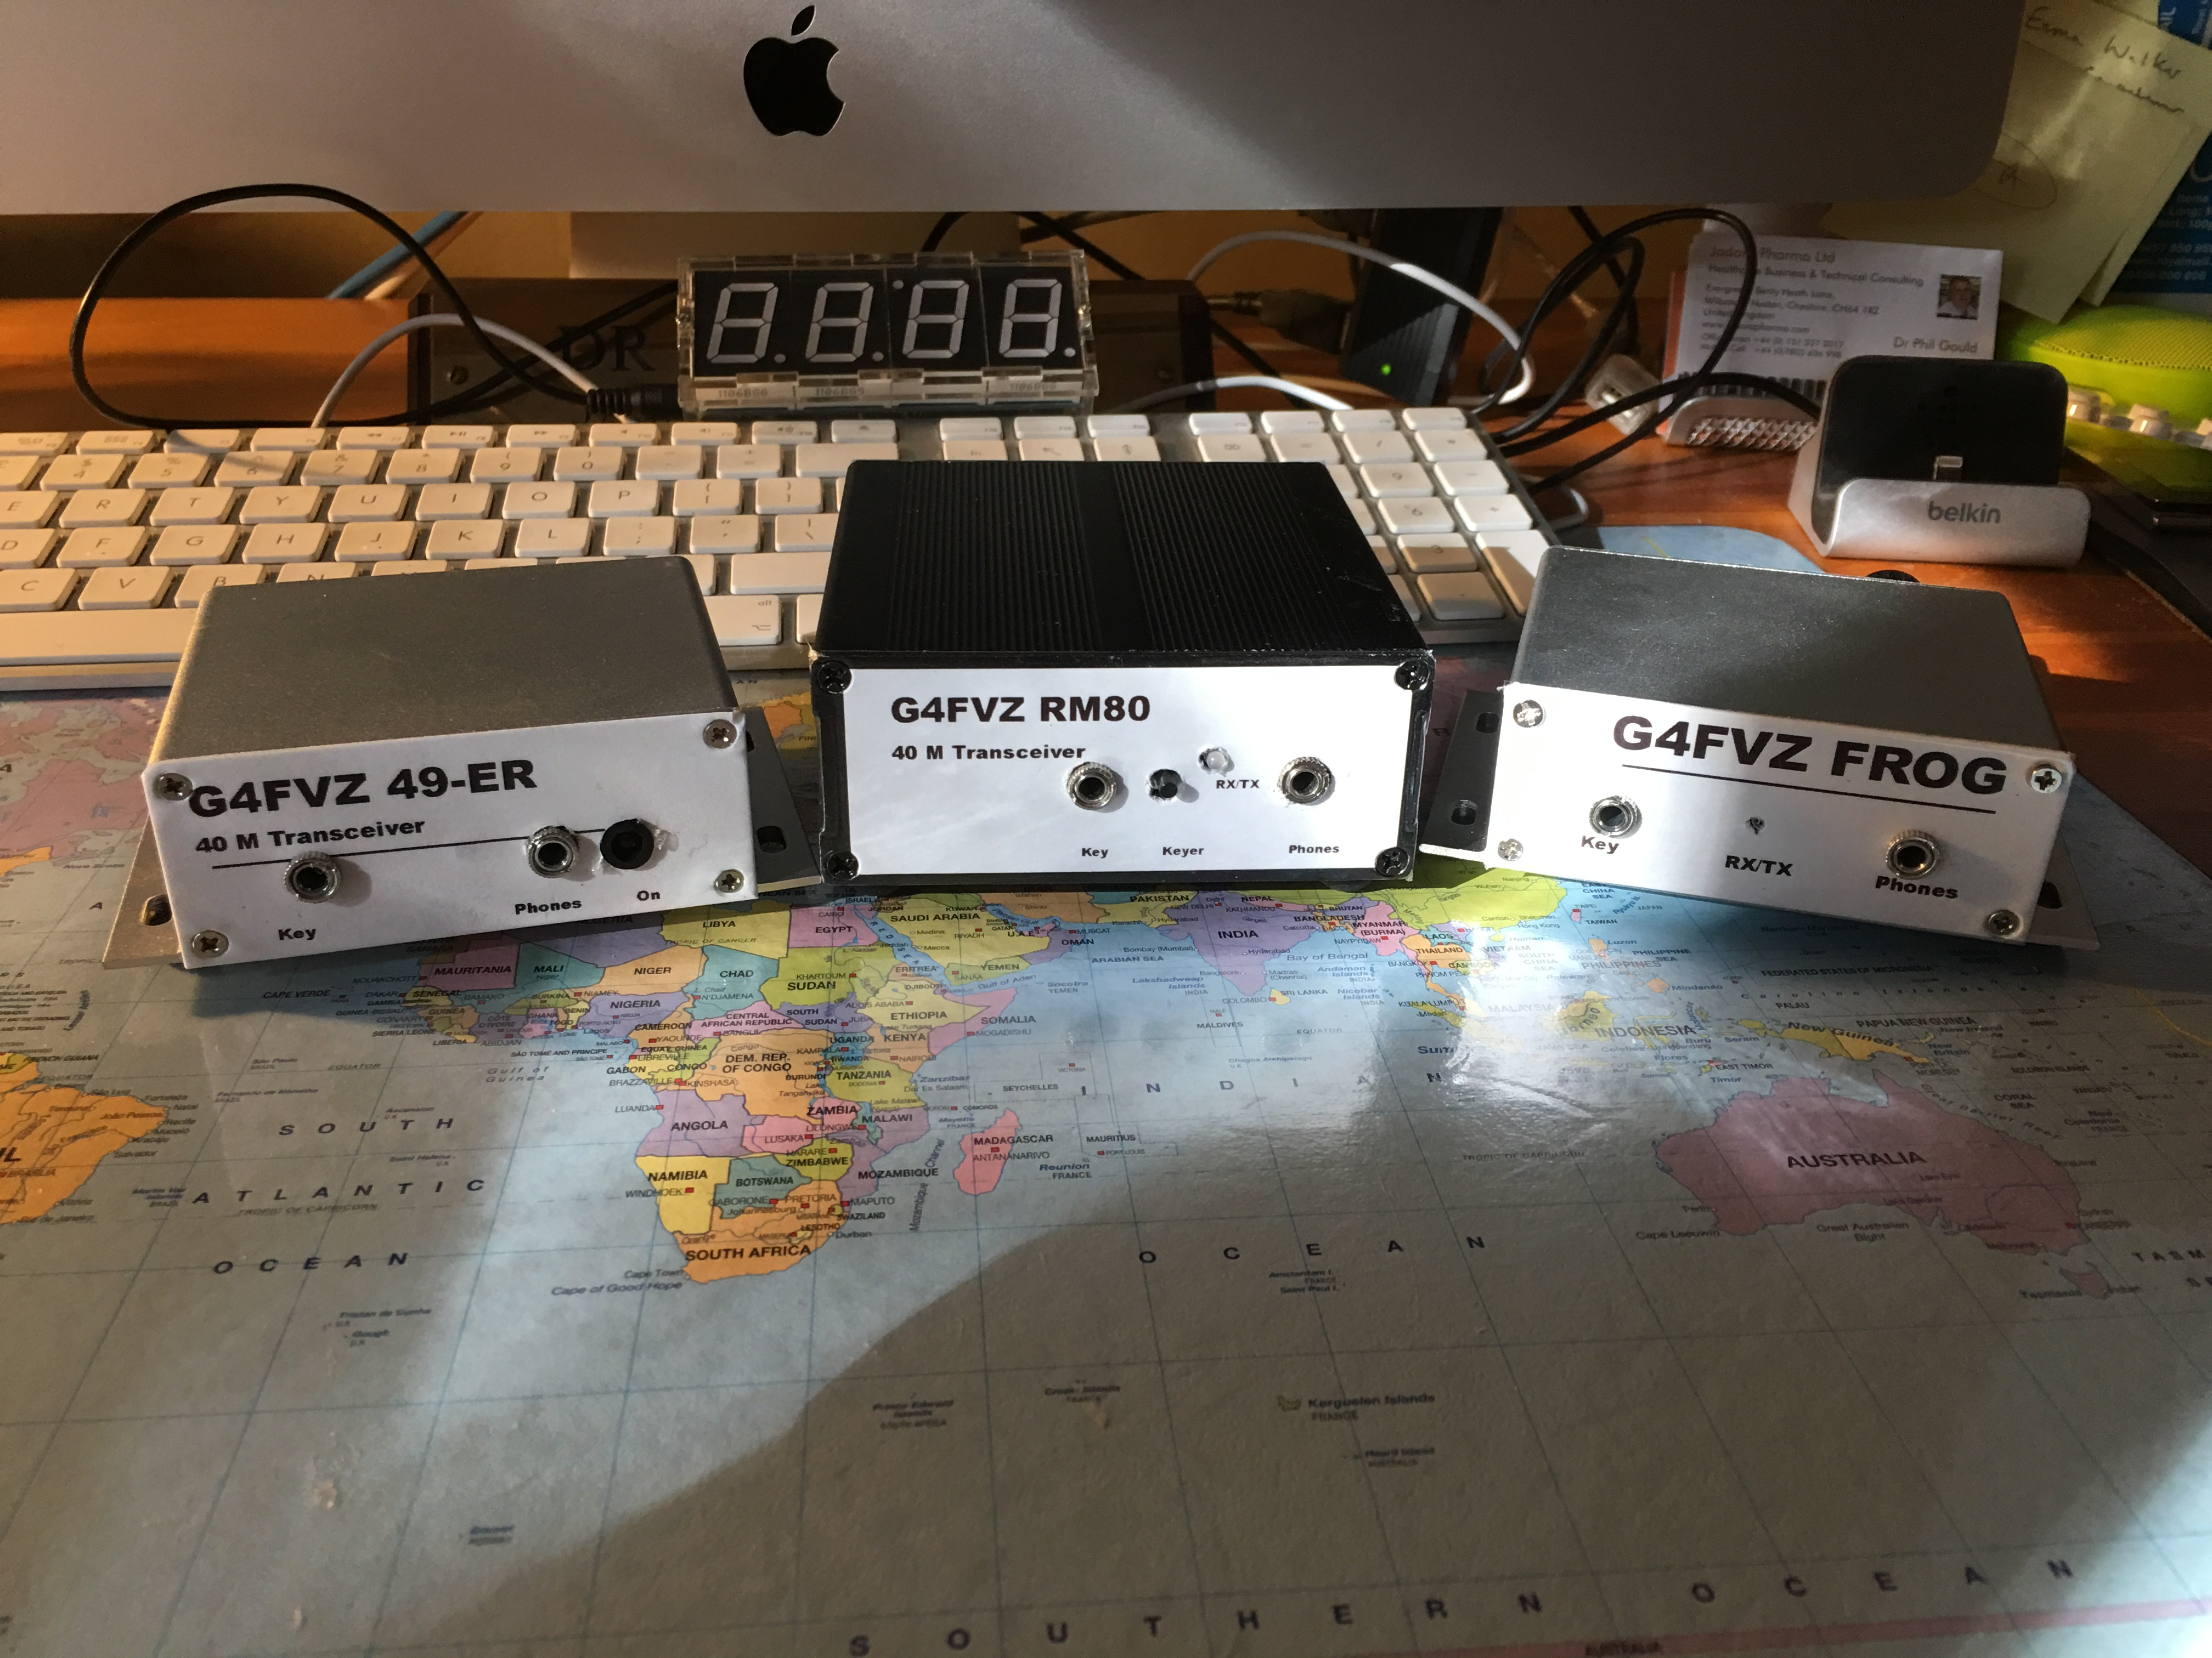
The Stable So far:

Slide 3
Low Cost ‘HAM’ Kits
Sourced from China and Hong Kong
  Ebay
  Amazon
  BangGood
Most of the time postage is free and customs duty under limit
Found to reliable in delivery – usually no more than 2 weeks
Chinese copies of US kits costing substantially more
Can be built as modules

Slide 4
But Buyer Beware!
Component quality is sometime doubtful
Some components not labelled
Components occasionally missing – usually they use a ‘handful’ approach
Companies have customer service – missing components – it works
Component boards are good quality but are sometime ‘changed’ from original
  Frog kit spoilt by mark V board
Inexpensive so sometimes ordering two for back up
Instruction limited- some English , some Chinese
Some components e.g. PA transistors probably ’not original’
  Stock of driver transistors and PA transistors

Slide 5
Test everything !
Test every component thoroughly
Mark as you go – circuit diagram and component list
Remember 2-2-2
PCB Boards double sided
Errors are difficult to correct once soldered
Try and socket the PA transistor – may need to change it
Heat sink the PA transistor
Don’t mix up the key and phones socket
Remember the dummy load

Slide 6
Starting Point
THE PIXIE £2.50
40m CW Transceiver
Crystal controlled on RX and TX (7.023)
No coils/torroids!
Some bandpass 2-3KHZ
A couple of watts – variable (0.5W)
Only drive headphones
Start up from fresh PP3 but 12V PSU
Only like to see 50Ω

Slide 7
Moving From The PIXIE To 49-er
£7.20
More power 2-3 W (0.5W more typical)
Still only drives headphones
Still Xtal controlled
  One for LO of RX/TX other for receiver front end filter
CW sidetone
Works reasonably well
Care with torroids T-37-2 is red!
Hissy

Slide 8
Forty-9er Circuit As Supplied

Slide 9
Moving ON TO RM-80 (super Rockmite)
Now up to 8W (5W)
PIC Keyer
Dense board
Circuit at limit (oscillastion)
4 torroids -2 transformers
Still only headphones output
£13
Could form the basis of transceiver
Super RM yahoo group
Can bypass keyer

Slide 10
What needs to be added?
Audio to drive speaker - ~£1- 2
Some preassembled, some kit
Fitted in same enclosure as 49-er/RM80
{Review quality of LM386}

Slide 11
And BPF
Make from G-QRP club
40M design
Cost about £1.50 using veroboard

Slide 12
And finally a case
Chinese source
  Aluminum or ABS
About £5

Slide 13
Final tally
49 –er £7.30 RM80 £13.50
Audio £2.50 Audio £ 2.50
LPF £2.00 LPF £ 2.00
Case £5.00 Case £ 7.00
£16.80
£25

Slide 14
Examples At G4FVZ : 49-er

Slide 15

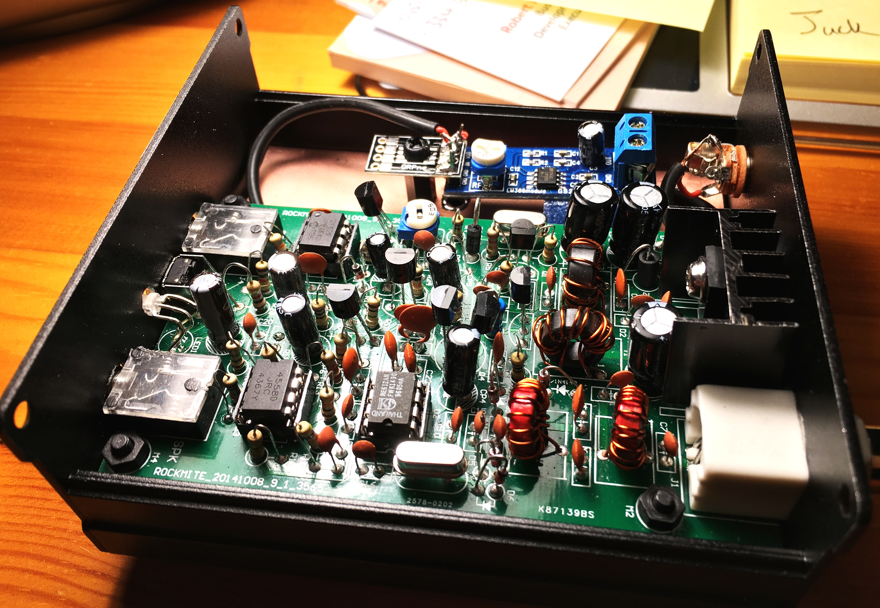
Examples At G4FVZ : RM 80

Slide 16
Frog Kit: Beware!
Pig to get going
Board changed and doesn’t match circuit diagram – R19 conundrum
Component quality particularly bad – PA transistor arrived in two pieces!
Driver and PA transistor changed to get output
US seemed to have more success

Slide 17
Summary : Pros and Cons
Can be built for £20 ; £25 if higher power/keyer
Project costs comes down with volume
Relatively easy homebrew project
No real major set up – multi-meter, component analyser, frequency meter
It works – CW QSO’s
But XTAL controlled – VFO?

Slide 18
Getting more Frequency Coverage : see KC9on.com

Slide 19
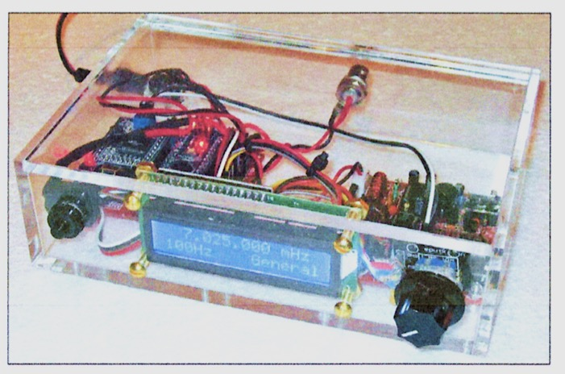
Linking A 49-Er to a DDS just out in Mar 2016 QST!

Slide 20
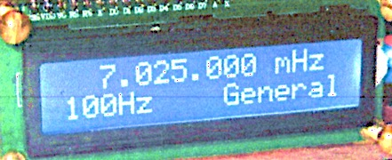
QST Article Shows How to MAKE LINK
All sourced from Ebay, Amazon etc
Uses Arduino nano, DDS module and LCD display
Additional parts – £12
Needs bigger case
Full TCR - £30?

Slide 21
Club Project?
Start with 49-er?
    Take bandpass as external control
    Socket up the PA transistor
    Consider buying better PA transistors
    Build a 20m variant
Transition it into a 40M DDS Arduino 49-er CW Transceiver
Gain volume of scale to reduce cost
Buildathon day?
Needs commitment of £25 per person

Slide 22
A 40m DDS VFO Transceiver
For £20 £25
Based on Homebrew Kits

